Slide 1
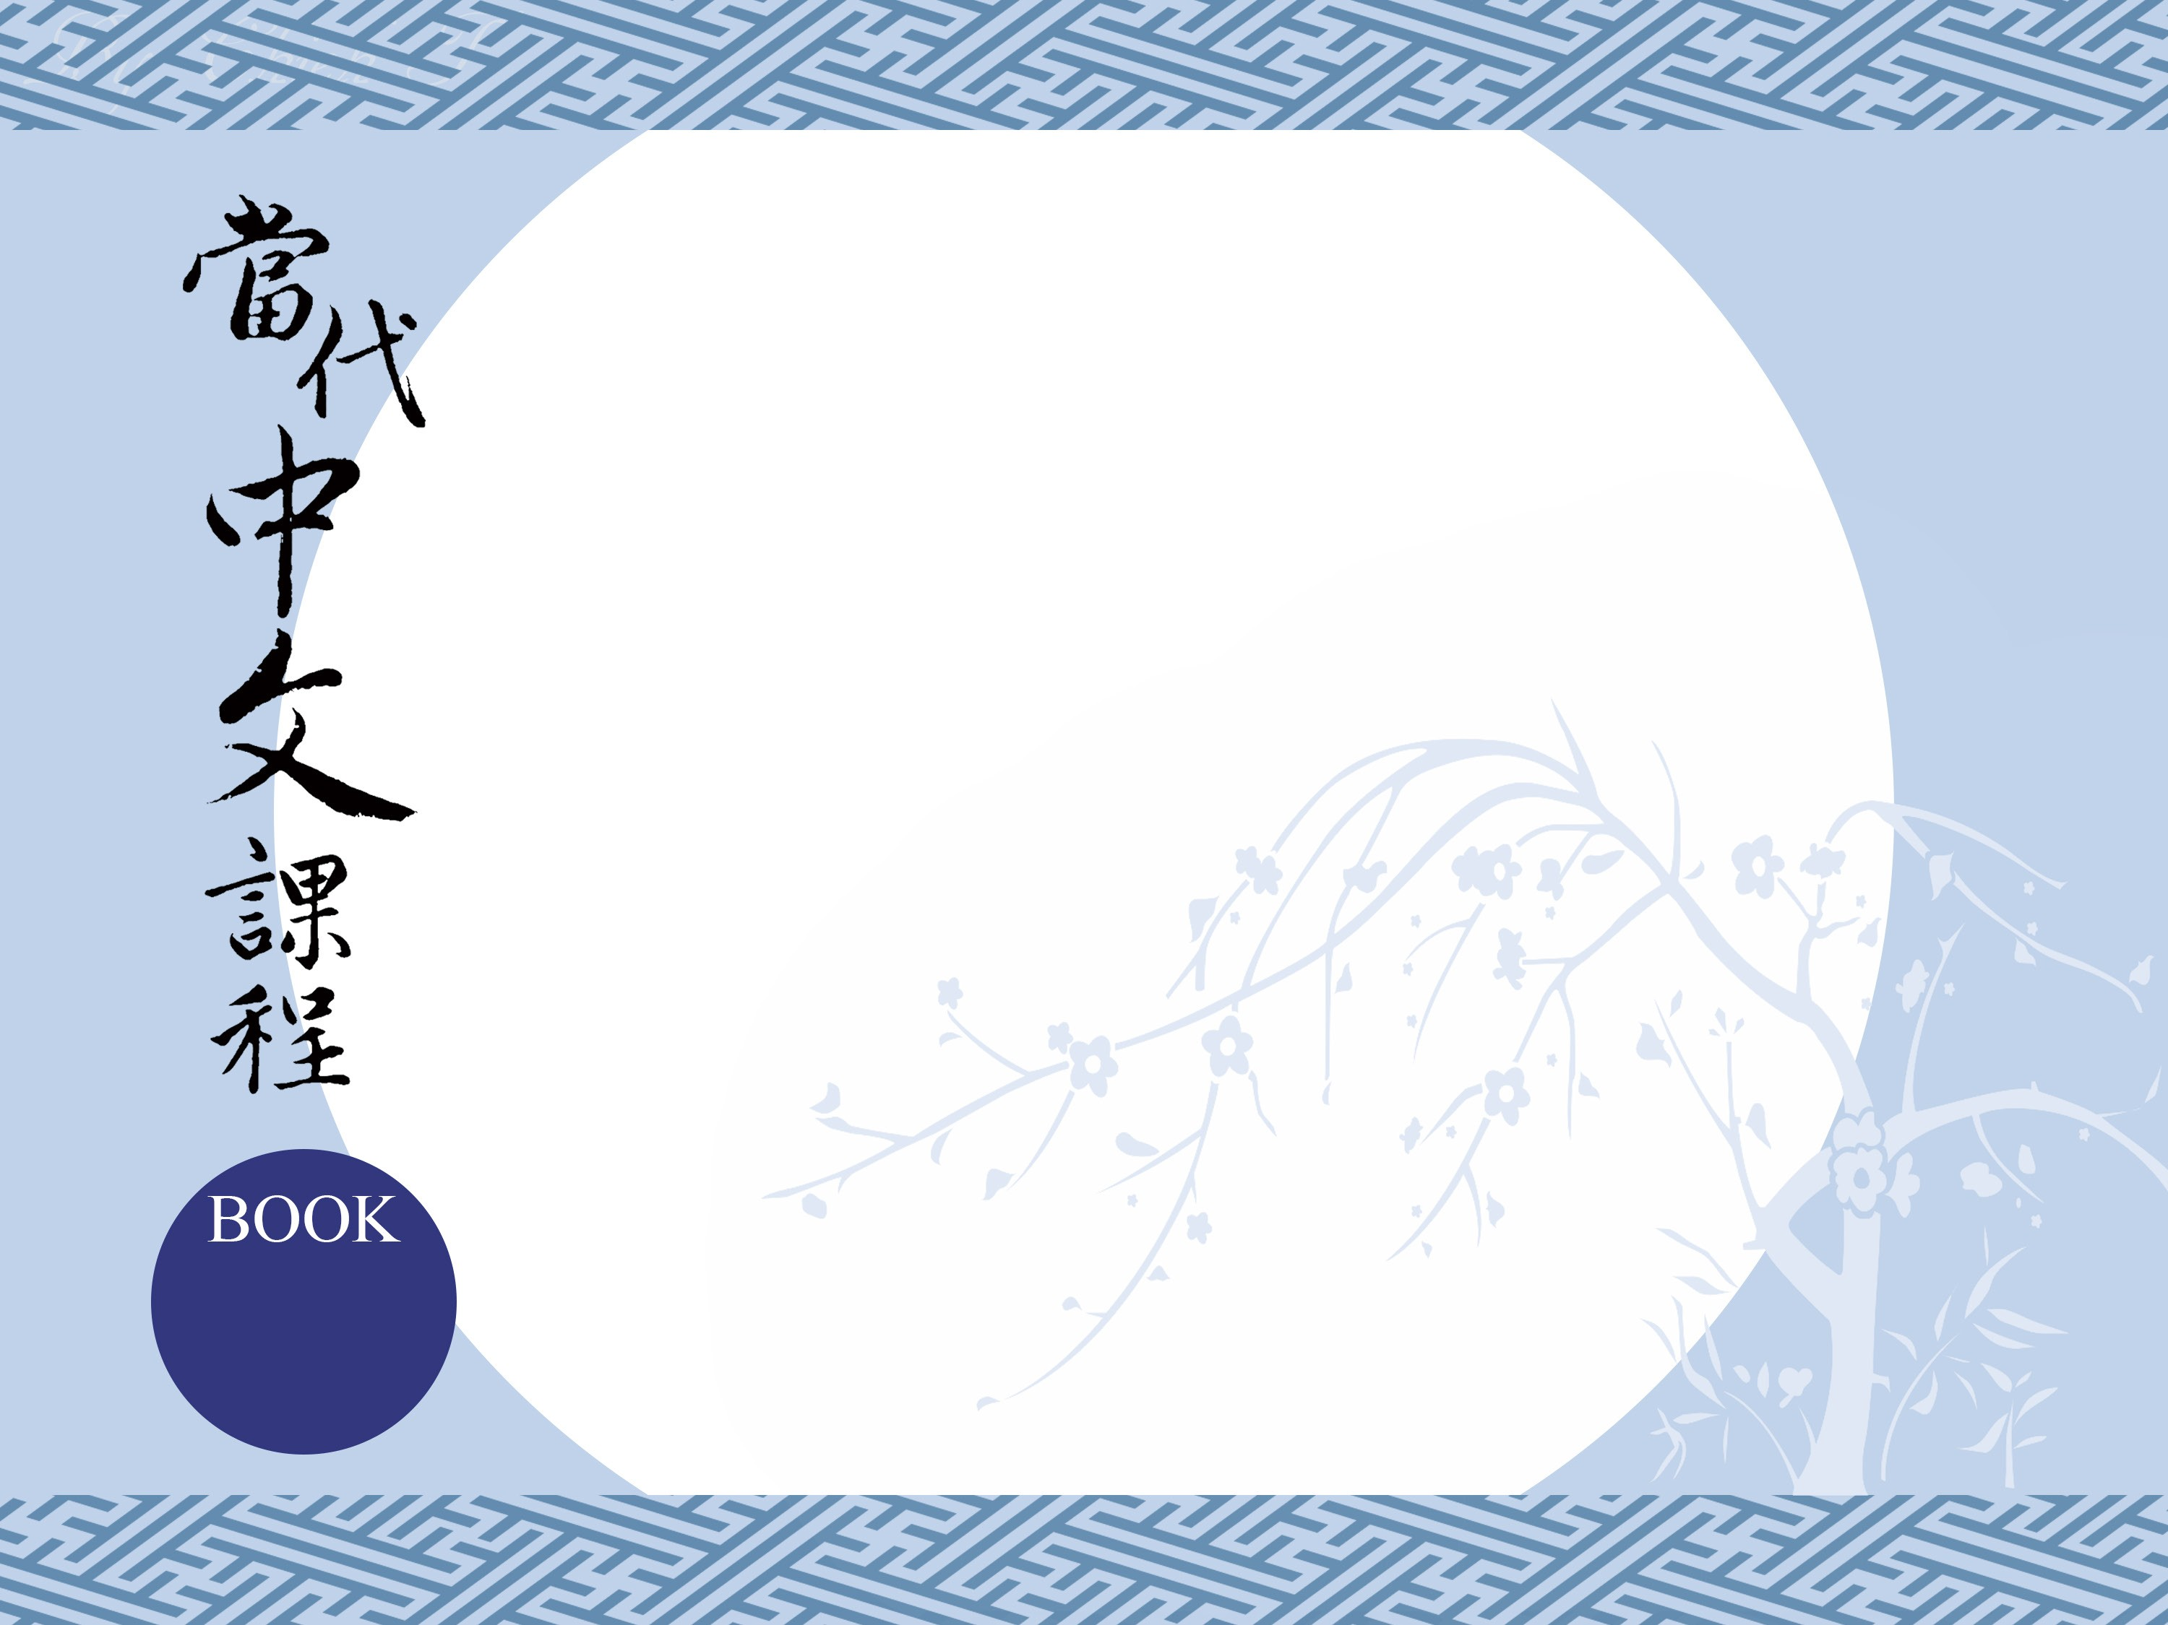
第十一課
台灣故事
The Story of Taiwan
3

Slide 2
I-1
建
jiàn
(V) to build (Classical Chinese)

Slide 3
I-2
重建
chóngjiàn
(V) to rebuild

Slide 4
I-3
到底
dàodǐ
(Adv) in the end, after all

Slide 5
I-4
世紀
shìjì
(N) century

Slide 6
I-5
貿易
màoyì
(N) trade

Slide 7
I-6
商業
shāngyè
(N) commerce, business

Slide 8
I-7
利益
lìyì
(N) gains, beneﬁt

Slide 9
I-8
派
pài
(V) to send, dispatch

Slide 10
I-9
軍隊
jūnduì
(N) army, military

Slide 11
I-10
燒
shāo
(V) to burn

Slide 12
I-11
城牆
chéngqiáng
(N) city walls, defensive walls

Slide 13
I-12
頭髮
tóufǎ
(N) hair

Slide 14
I-13
甚至
shènzhì
(Adv) even, even to the point of

Slide 15
I-14
打仗
dǎzhàng
(V-sep) to engage in warfare

Slide 16
I-15
少數
shǎoshù
(N) minority, a few

Slide 17
I-16
開墾
kāikěn
(V) to open up land for farming

Slide 18
I-17
將軍
jiāngjūn
(N) general

Slide 19
I-18
軍人
jūnrén
(N) military service member

Slide 20
I-19
平原
píngyuán
(N) ﬂatland, plains

Slide 21
I-20
人口
rénkǒu
(N) population

Slide 22
I-21
血統
xiětǒng
(N) blood, bloodline

Slide 23
I-22
嘍
lou
(Ptc) a sentence-ﬁnal particle meaning 'in that case'

Slide 24
I-23
孫子
sūnzi
(N) grandson

Slide 25
I-24
領土
lǐngtǔ
(N) territory (of a nation)

Slide 26
I-25
男性
nánxìng
(N) male

Slide 27
I-26
禁止
jìnzhǐ
(V) to forbid

Slide 28
I-27
娶
qǔ
(V) to take a woman in marriage

Slide 29
I-28
相信
xiāngxìn
(Vst) to believe

Slide 30
I-29
精彩
jīngcǎi
(Vs) splendid, brilliant as (of a performance)

Slide 31
I-30
紅毛城
Hóngmáo chéng
． Fort Santo Domingo, lit. red-hair city

Slide 32
I-31
東方
Dōngfāng
． the East, the Orient

Slide 33
I-32
淡水
Dànshuǐ
． Tamsui

Slide 34
I-33
漢人
Hàn rén
． Han-ethnic Chinese

Slide 35
I-34
鄭成功
Zhèng Chénggōng
Koxinga, 國姓爺 , 1624-1662, who ruled
Taiwan against the Manchu sovereignty

Slide 36
I-35
明朝
Míng cháo
． Ming Dynasty, 1368-1644

Slide 37
中南美洲
Zhōngnán Měizhōu
I-36
． Central and South America

Slide 38
I-37
清朝
Qīng cháo
． Qing Dynasty, 1644-1911

Slide 39
大清帝國
Dàqīng dìguó
I-38
． the Qing Empire

Slide 40
I-39
輪到
lúndào
． one's turn, it's up to

Slide 41
I-40
十七世紀初
shíqī shìjì chū
． early 17th century

Slide 42
I-41
打敗
dǎ bài
． to defeat

Slide 43
I-42
十七世紀末
shíqī shìjì mò
． late 17th century

Slide 44
II-1
餐桌
cānzhuō
(N) dining table

Slide 45
II-2
中式
Zhōngshì
(N) Chinese-style

Slide 46
II-3
套
tào
(M) set of (books, clothes, equipment etc)

Slide 47
II-4
燒餅
shāobǐng
(N) clay oven sesame seed biscuits, like Indian ‘nan’

Slide 48
II-5
油條
yóutiáo
(N) deep-fried dough sticks

Slide 49
II-6
飯糰
fàntuán
(N) rice rolls with various ﬁllings

Slide 50
II-7
豆漿
dòujiāng
(N) soy milk

Slide 51
II-8
內戰
nèizhàn
(N) civil war

Slide 52
II-9
人民
rénmín
(N) the people

Slide 53
II-10
攤子
tānzi
(N) roadside stand, vendor's stall

Slide 54
II-11
菜單
càidān
(N) menu

Slide 55
II-12
蘿蔔
luóbo
(N) daikon radish

Slide 56
II-13
接著
jiēzhe
(Adv) to continue, to pick up where something left
oﬀ

Slide 57
II-14
戰爭
zhànzhēng
(N) war

Slide 58
II-15
不斷
búduàn
(Vs) continual, incessant

Slide 59
II-16
遷移
qiānyí
(Vi) to migrate

Slide 60
II-17
多半
duōbàn
(Adv) mostly, in the majority of cases

Slide 61
II-18
困難
kùnnán
(Vs) diﬃcult

Slide 62
II-19
節儉
jiéjiǎn
(Vs) frugal

Slide 63
II-20
主婦
zhǔfù
(N) housewife

Slide 64
II-21
煎
jiān
(V) to pan fry

Slide 65
II-22
菜色
càisè
(N) variety of dishes

Slide 66
II-23
以及
yǐjí
(Conj) and, as well as

Slide 67
II-24
美味
měiwèi
(Vs) delicious

Slide 68
II-25
點心
diǎnxīn
(N) desserts

Slide 69
II-26
日式
Rìshì
(N) Japanese-style

Slide 70
II-27
飲食
yǐnshí
(N) food, diet

Slide 71
II-28
深
shēn
(Vs) deep

Slide 72
II-29
蔣介石
Jiǎng Jièshí
． Chiang Kai-Shek, 1887-1975

Slide 73
II-30
國共內戰
Guó Gòng nèizhàn
the Chinese Civil War (i.e., between the Kuomintang and the Communists), 1927-1937, 1945-1950

Slide 74
II-31
客家人
Kèjiā rén
． the Hakka people, a branch of Han

Slide 75
II-32
閩南人
Mǐnnán rén
． the Southern Min people, also called Hokkien

Slide 76
II-33
蛋餅
dàn bǐng
． an egg wrap

Slide 77
II-34
打輸
dǎ shū
． to be defeated

Slide 78
II-35
擺攤子
bǎi tānzi
． to set up a vendor's stall

Slide 79
II-36
蘿蔔糕
luóbo gāo
． daikon cakes

Slide 80
II-37
烹飪課
pēngrèn kè
． cooking class

Slide 81
II-38
曬乾
shài gān
． to sun dry

Slide 82
各種各樣
gèzhǒng gèyàng
II-39
． various types

Slide 83
殖民統治
zhímín tǒngzhì
II-40
． to colonise and rule

Slide 84
II-41
味噌湯
wèizēng tāng
． miso soup (Japanese food)

Slide 85
II-42
蘿蔔乾
luóbo gān
． dried daikon

Slide 86
II-43
進一步
jìn yī bù
． further

